Slide 1
Analytics with Excel
Kunaal Naik

Slide 2
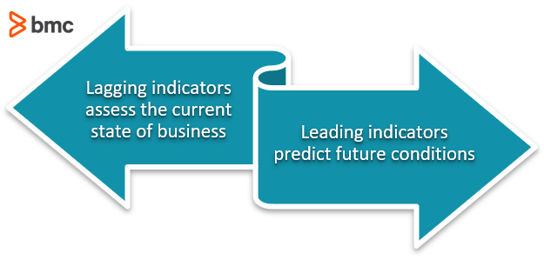
Analytics
A detailed study or examination of something to understand more about it.
Simply put, we analyze Business through Metrics and KPI’s and take actions to either increase Revenue or reduce/optimize costs.
How to look at metrics?

Slide 3
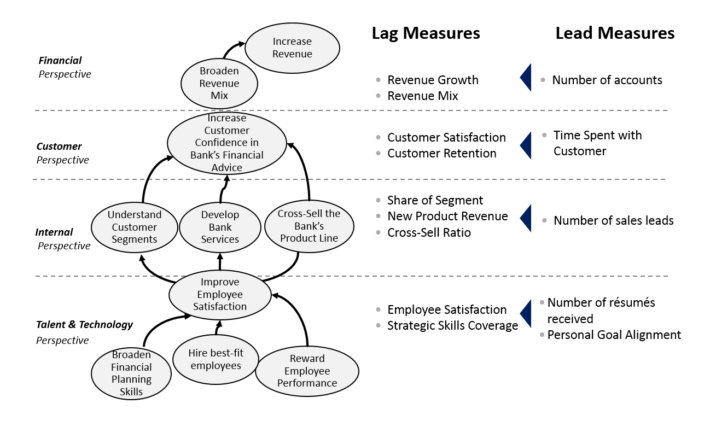

Slide 4
ANALYTICS with EXCEL
REPORTING
What happened?
> Cricket Scorecard
Analysis and monitoring
Why did it happen?
> Why someone got out? Why did Virat not perform?
Predictive analytics
What will happen?
> Will India win the Finals?
Prescriptive analytics
What should I do next?
> What team to choose for next season?

Slide 5
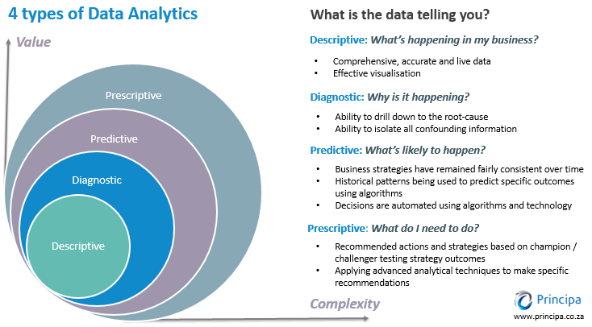

Slide 6
What is possible on EXCEL?
Descriptive/Diagnostic
(Reporting)
Predictive/Prescriptive
(Data Science/ Machine Learning)
Performance Scorecards A performance scorecard is a graphical representation of the progress over time
Balanced Scorecards The balanced scorecard allows managers to look at the business from four important perspectives
Dashboards A type of GUI which often provides at-a-glance views of key performance indicators
Statictics T-test, ANOVA, Histogram, Decriptive Statistics
Regression Predict continuous output – Price, Salary
Forecasting Forecast a metric into the future – Forecast Sales

Slide 7
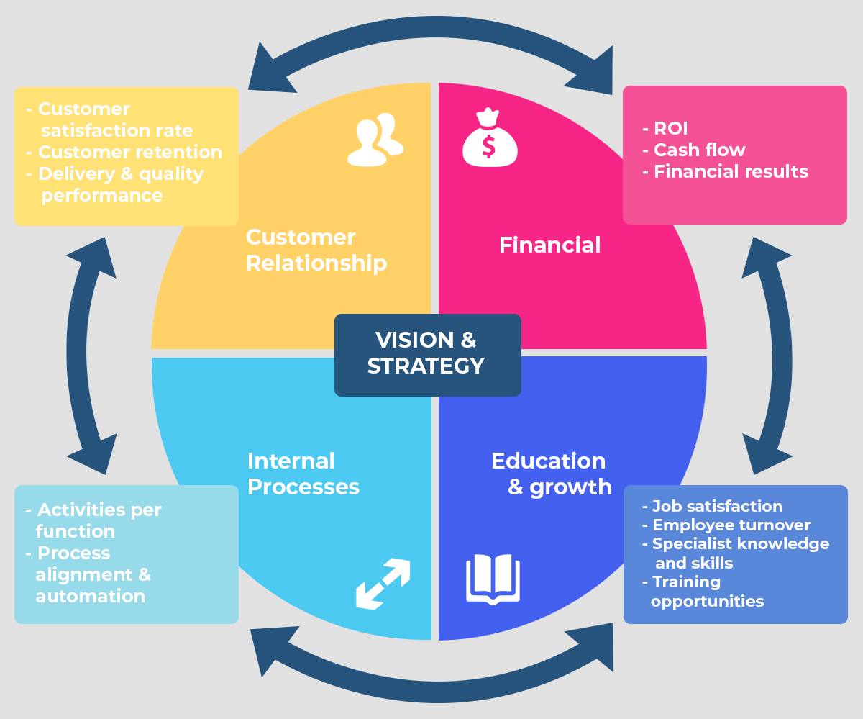
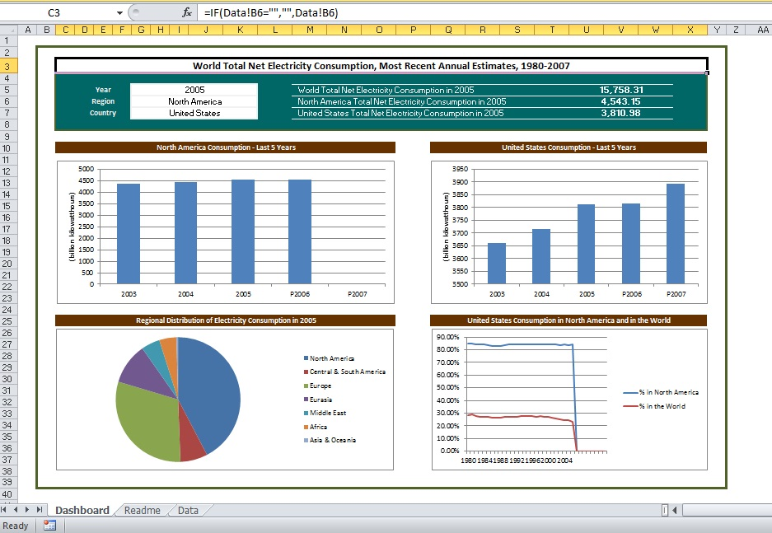
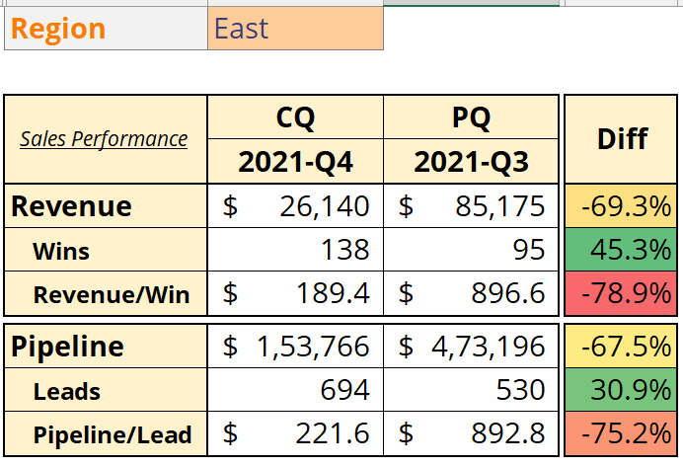
Excel Scorecard/Dashboard
Performance scorecard
Balanced SCORECARD
Excel Dashboards

Slide 8
DATA SCIENCE - MODELs
Regression and Classification algorithms are Supervised Learning algorithms. Both the algorithms are used for prediction in Machine learning and work with the labeled datasets. But the difference between both is how they are used for different machine learning problems.
When we do not have labeled data and need to find the hidden patterns from the given dataset. We need unsupervised learning techniques.
Forecasting is a technique that uses historical data as inputs to make informed estimates that are predictive in determining the direction of future trends.
Regression
Regression is a process of finding the correlations between dependent and independent variables. It helps in predicting the continuous variables such as prediction of Market Trends, prediction of House prices, etc.
Supervised Learning
Classification
Classification is a process of finding a function which helps in dividing the dataset into classes based on different parameters. In Classification, a computer program is trained on the training dataset and based on that training, it categorizes the data into different classes.
Supervised Learning
Clustering
Clustering is the task of dividing the population or data points into a number of groups such that data points in the same groups are more similar to other data points in the same group and dissimilar to the data points in other groups. It is basically a collection of objects on the basis of similarity and dissimilarity between them.
Unsupervised Learning
Forecasting
Timeseries forecasting in simple words means to forecast or to predict the future value(eg-stock price) over a period of time.
Time Series
Notes:
https://www.javatpoint.com/regression-vs-classification-in-machine-learning
https://www.javatpoint.com/unsupervised-machine-learning
https://www.analyticsvidhya.com/blog/2021/07/time-series-forecasting-complete-tutorial-part-1/
https://www.geeksforgeeks.org/clustering-in-machine-learning/

Slide 9
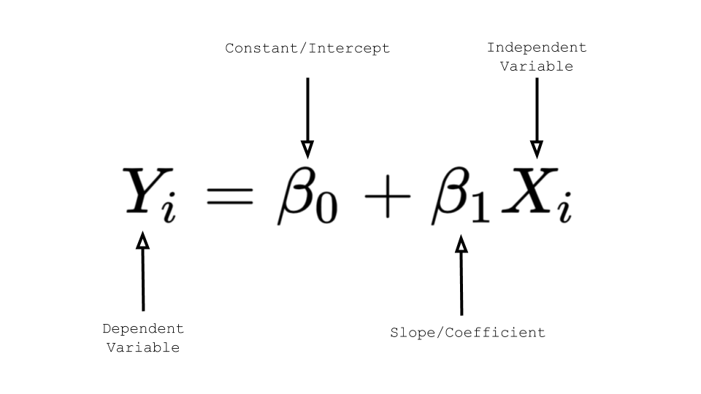
Regression
OUTPUT (y, dependent variable)
Continuous nature or real value (House Price, Salary)
DATA (X, y)
The task of the regression algorithm is to map the input value (x) with the continuous output variable(y)
DATA PREPROCESSING
Missing Value, Outliers, Normalization/Standardization, Correlation Matrix
METRIC
R Squared, Mean Squared Error, Root Mean Squared Error

Slide 10
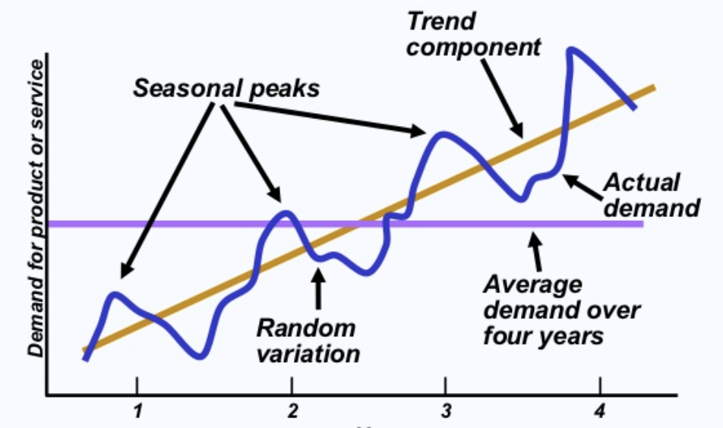
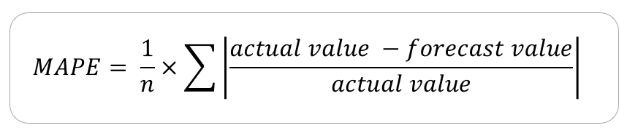
TIME SERIES Forecasting
OUTPUT (y, time-based value)
Future Value based on time (Coal Price, Demand Forecasting)
DATA (y)
Forecasting uses the series along with time to forecast into the future
DATA PREPROCESSING
Moving Average, Lagging, Central Moving Average, Trend, Seasonality, Cyclicity, etc …
METRIC
Notes:
https://www.analyticsvidhya.com/blog/2021/07/time-series-forecasting-complete-tutorial-part-1/

Slide 11
Hands on

Slide 12
Case Study
Regression
FORECASTING
SCORECARD
Data - Marketing Spends
Objective – Optimize Marketing spends for maximum Sales
Data – Sales
Objective – Forecast 1 year Sales for Strategy Planning
Data – Marketing and Sales
Objective – Build a Performance Scorecard to show Pipeline and Revenue metrics
Metrics – Revenue, Wins, Revenue/Win, Pipeline, Leads, Pipeline/Lead

Slide 13
SOLUTION
CLOSE THE GAP
TARGET AUDIENCE
Our product makes consumer lives easier, and no other product on the market offers the same features
Our target audience is Gen Z (18-25 years old)
COST SAVINGS
EASY TO USE
Reduce expenses for replacement products
Simple design that gives customers the targeted information they need

Slide 14
PRODUCT OVERVIEW
UNIQUE
Only product specifically dedicated to this niche market
FIRST TO MARKET
First beautifully designed product that's both stylish and functional
TESTED
Conducted testing with college students in the area
AUTHENTIC
Designed with the help and input of experts in the field

Slide 15
PRODUCT BENEFITS
Cool and stylish product
Areas for community connections
Online store and market swap

Slide 16
COMPANY OVERVIEW

Slide 17
BUSINESS MODEL
ABSTRACT
We based our research on market trends and social media
DESIGN
We believe people need more products specifically dedicated to this niche market
RESEARCH
Minimalist and easy to use

Slide 18
MARKET OVERVIEW
$3 Billion
$1 Billion
$2 Billion
Freedom to invent
Selectively inclusive market
Serviceable available market
Opportunity to build
Fully inclusive market
Total addressable market
Few competitors
Specifically targeted market
Serviceable obtainable market

Slide 19
Market comparison
$3B
$2B
$1B
Opportunity to build
Freedom to invent
Few competitors
Addressable market
Serviceable market
Obtainable market

Slide 20
OUR COMPETITION
CONTOSO
COMPETITORS
Our product is priced below that of other companies on the market
Design is simple and easy to use, compared to the complex designs of the competitors
Affordability is the main draw for our consumers to our product
Company A Product is more expensive
Companies B & C Product is expensive and inconvenient to use
Companies D & E Product is affordable, but inconvenient to use

Slide 21
Our competition
Convenient
Contoso
Competitor A
Affordable
Expensive
Competitor D
Competitor C
Competitor B
Competitor E
Inconvenient

Slide 22
Growth strategy
Feb 2022
Roll out product to high profile or top-level participants to help establish the product
Mar 2022
Release the product to the general public and monitor press release and social media accounts
Oct 2022
Gather feedback and adjust product design as necessary

Slide 23
TRACTION
Forecasting for success
Key Metrics
 | Clients | Orders | Gross revenue | Net revenue
2022 | 10 | 1100 | $10,000 | $7,000
2022 | 20 | 200 | $20,000 | $16,000
2022 | 30 | 300 | $30,000 | $25,000
2022 | 40 | 400 | $40,000 | $30,000
REVENUE BY YEAR

Slide 24
TWO-YEAR ACTION PLAN
DRAFT BLUEPRINTS
GATHER FEEDBACK
DELIVER TO CLIENT
2022
JAN
FEB
MAR
APR
MAY
JUN
JUL
AUG
SEP
OCT
NOV
DEC
2022
JAN
FEB
MAR
APR
MAY
JUN
JUL
AUG
SEP
OCT
NOV
DEC
RUN FOCUS GROUPS
TEST DESIGN
LAUNCH DESIGN

Slide 25
FINANCIALS
 | Year 1 | Year 2 | Year 3
INCOME
Users | 50,000 | 400,000 | 1,600,000
Sales | 500,000 | 4,000,000 | 16,000,000
Average price per sale | 75 | 80 | 90
Revenue @ 15% | 5,625,000 | 48,000,000 | 216,000,000
GROSS PROFIT | 5,625,000 | 48,000,000 | 216,000,000
Expenses
Sales & marketing | 5,062,500 | 38,400,000 | 151,200,000 | 70%
Customer service | 1,687,500 | 9,600,000 | 21,600,000 | 10%
Product development | 562,500 | 2,400,000 | 10,800,000 | 5%
Research | 281,250 | 2,400,000 | 4,320,000 | 2%
TOTAL EXPENSES | 7,593,750 | 52,800,000 | 187,920,000

Slide 26




MEET THE TEAM
TAKUMA HAYASHI​
MIRJAM NILSSON​
FLORA BERGGREN​
RAJESH SANTOSHI​
President
Chief Executive Officer
Chief Operations Officer
VP Marketing

Slide 27








MEET THE TEAM
TAKUMA HAYASHI
MIRJAM NILSSON​
FLORA BERGGREN​
RAJESH SANTOSHI
President
Chief Executive Officer
Chief Operations Officer
VP Marketing
GRAHAM BARNES
ROWAN MURPHY
ELIZABETH MOORE
ROBIN KLINE
VP Product
SEO Strategist
Product Designer
Content Developer

Slide 28
FUNDING
$14,000
$12,000
$82,000
$32,000
ANGEL INVESTMENTS
PROPERTY
SHARES
CASH
Amount obtained through other investors
Revenue obtained from property rentals
Number of shares converted into USD
Liquid cash we have on hand

Slide 29
SUMMARY
At Contoso, we believe in giving 110%. By using our next-generation data architecture, we help organizations virtually manage agile workflows. We thrive because of our market knowledge and great team behind our product. As our CEO says, "Efficiencies will come from proactively transforming how we do business.”

Slide 30
THANK YOU
Mirjam Nilsson​
206-555-0146
mirjam@contoso.com
www.contoso.com

